Slide 1

Ratepayer Impact Study
Stakeholder Meeting
March 25, 2022

Slide 2
Meeting Moderator:
Dianne Crilly
Office of the Economist
New Jersey Board of Public Utilities
03/25/2022
www.nj.gov/bpu

Slide 3
Stakeholder Process
The focus of this stakeholder meeting is to solicit
input on study design criteria and assumptions
for a Ratepayer Impact Study of
clean energy policies presented in the most
recent Energy Master Plan
03/25/2022
www.nj.gov/bpu

Slide 4
Stakeholder Process
Please feel free to ask clarifying questions in the Q&A box during the presentation by The Brattle Group.
There will be an opportunity to present general comments after the presentation and also a public comment period through April 8, 2022.
A recording of this presentation and the slides will be made available at https://www.bpu.state.nj.us/bpu/newsroom/public/.
03/25/2022
www.nj.gov/bpu

Slide 5
Opening Remarks:
Abe Silverman
General Counsel
New Jersey Board of Public Utilities
03/25/2022
www.nj.gov/bpu

Slide 6
New Jersey Energy Master Plan – Ratepayer Impact Study
Overview of Scope and Approach
Prepared By
  Sanem Sergici
  Kathleen Spees
  Goksin Kavlak
  Rohan Janakiraman
Prepared For
  New Jersey Board of
  Public Utilities
MARCH 25, 2022

Slide 7
Agenda
1- Meeting Objectives
2- Study Overview
  Purpose of the Study
  Primary Study Questions
  High-level Approach
3- Analytical Approach
  Model Architecture Overview
  Scenario Assumptions
  Energy Demand and Supply
  Statewide Program Costs
  Utility Rates and Energy Bills
4- Discussion

Slide 8
Stakeholder Meeting Objective
EMP Ratepayer Impact Study is aimed at understanding the impact of the EMP on customers’ energy costs through a comprehensive analysis of rate impacts and overall energy costs as of 2030
Our objective with this meeting is to:
  Present study scope and approach
  Discuss primary questions the study will aim to answer
  Solicit input from stakeholders on proposed study design and key assumptions

Slide 9
Study Overview

Slide 10
Purpose of This Study
overview
New Jersey is pursuing a number of coordinated clean energy policies to decarbonize its economy and achieve 100% clean energy by 2050.
The 2019 Energy Master Plan (EMP) evaluated a core set of policy strategies for achieving these economy-wide greenhouse gas reduction (GHG) outcomes in the most cost-effective manner.
While the 2019 EMP established a least cost pathway to achieving targeted GHG outcomes, it did not evaluate the net cost of these incremental programs to customers.
This study is aimed at understanding the impact of these pathways on net energy costs incurred by customers, through a comprehensive analysis of rate and bill impacts in 2030

Slide 11
High Level Approach
overview
This study will incorporate the findings of the 2019 EMP into a comprehensive model of customer rate and energy cost impacts across the state of New Jersey after disaggregating associated costs by utility, mode of energy consumption and customer segment.
  The rates and energy costs will be calculated for 2030, and not for the interim years.
Additionally, the Study will evaluate the costs and benefits of legally binding policies that have been enacted since then, including:
  Requirements of the Solar Act of 2021
  Executive Order No. 92, which increased New Jersey’s offshore wind targets to 7,500 MW by 2035
  Executive Order No. 274, which directed the State to reduce GHG emissions to 50% below 2006 levels by 2030
  The Board’s energy efficiency orders
  Other comparable requirements related to electric vehicles (EVs) and other programs

Slide 12
Model Scenarios
overview
The Study will include a comprehensive analysis of energy costs for residential and commercial and industrial (C&I) customers, for both electricity and natural gas service.
The Study anticipates analyzing expected ratepayer energy costs in 2030 under the following scenarios and compare them to costs in a recent year in 2022 dollars.
Scenario | Description
1. Current Policy Pathway Case | Includes the total costs and benefits of clean energy programs that are currently enshrined in New Jersey policies and consistent with current market trajectory
2. EMP Achievement Case | Developed from EMP “Least Cost” pathway Includes total costs and benefits of clean energy programs that would be necessary to meet the EMP’s “Least Cost” pathway, which is designed to result in 100% clean energy by 2050
3. Ambitious Pathway Case | Evaluates relative energy costs associated with earlier achievement of 100% clean electricity in 2035 from 2050
  In addition, the Study will include a sensitivity analysis to examine the change to emissions and total consumer energy costs that would be estimated under alternative study assumptions, such as higher levels of electric vehicle adoption or building decarbonization efforts.

Slide 13
Study Building Blocks
overview
For each of the model scenarios, this analysis will consider the following factors to compute the energy costs for 2030:
Gross costs of EMP program implementation in 2030
Reductions to energy consumption driven by increased efficiency
Shifts in energy consumption in heating and transportation towards increased electricity usage
Changes to electricity and natural gas rates as program, variable, and embedded system costs are applied across changing electricity and gas volumes
Energy costs in 2030 for average customers from each class
  Note: Energy costs will be computed for 2030, not the interim years.

Slide 14
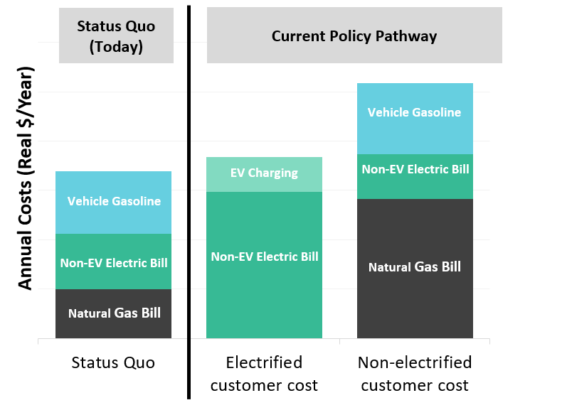
Illustrative Primary Study Results: Total Energy Cost by Customer Segment
overview
Illustration of Residential Customer Total Annual Energy Costs (not intended to reflect NJ EMP)
Primary Study results will show the total annual energy expenses for utility bills and gasoline car or EV
  This will be obtained for different customer profiles, by class, and by utility for each case
  We may also express residential energy costs in terms of energy burden, i.e., total energy expense as a share of annual income
Two customer profiles (electrified and non-electrified) are used to illustrate energy costs on different customer types, but we expect to model other profiles including those for low and moderate income customers

Slide 15
Illustrative Primary Study Results: Total Energy Cost by Customer Segment (cont.)
overview
Illustration of Residential Customer Total Annual Energy Costs (not intended to reflect NJ EMP)
Costs in Scope:
  Electricity and gas customer bills
  Gasoline or EV charging costs
Costs Not in Scope:
  Taxpayer-funded programs (unless those programs offset the costs of the above)
  Private consumer costs of purchasing EVs
  Private companies’ costs (other than those paid as C&I consumer electric and gas bill)
  Busing/public transport costs

Slide 16
Primary Study Questions
overview
For each of the “Current Policy Pathway”, EMP Achievement”, and “Ambitious Pathway” scenarios, we aim to answer the following questions:
  What are the expected total consumer energy costs as of 2030, considering direct costs of clean energy programs and associated changes to electricity and natural gas rates to recover these costs?
  What are the economic benefits and savings to consumers, such as through reduced gasoline, natural gas, and electricity consumption?
  What are the net consumer costs in the form of “total energy bills”, when considering consumers’ total energy costs for all primary uses of energy (electricity, natural gas, and gasoline)?
  How might each customer segment be impacted under each of the model scenarios? Are low-income or any other customer segments at risk of disproportionate impacts associated with the incidence, timing, or details of any elements within the EMP?
  How would consumer total energy costs be affected under alternative pathways to meet the State’s solar targets post 2027? How will acceleration of targets for efficiency and electrification achievement affect total consumer energy costs?

Slide 17
Analytical Approach

Slide 18
Model Architecture
approach
Step 1: Define scenario inputs
Step 2: Determine statewide energy demand
Step 3: Determine residual supply
Step 4: Calculate statewide program costs
Step 5: Calculate rates for each utility
Step 6: Calculate consumer energy costs
Demand
Energy efficiency targets for electric and gas utilities
Supply
Solve for residual class I RECs after solar and OSW; and non-renewable generation.
Electricity Costs
Solar
Storage
Offshore wind
Nuclear
NJCEP
Utility-run EE and EV programs
Other Class I RECs
Costs per Utility
Allocate costs to utilities based on sales
Customer Profiles
Create different types of residential and C&I customer profiles
Electricity Demand
Baseline demand
Adjustment due to EE
Adjustment due to transportation electrification
Transportation electrification assumptions
Electricity and Gas Rates
Obtain baseline revenue in a recent year
Calculate distribution rates in 2030
Allocate EMP costs to delivery surcharges
Residential
Utility bills based on residential rates and use per customer
Transportation: EV or conventional vehicle operation costs
Building decarbonization assumptions
Natural Gas Demand
Baseline demand
Adjustment due to EE
Adjustment due to building decarbonization
Natural Gas Costs
NJCEP costs
Utility-run EE programs
Technology efficiencies (for EVs, heat pumps, and incumbent tech.)
Small and Large C&I
Utility bills based on C&I rates and use per customer
Supply
Targets for quantities of renewables
Utility sales by customer class
Prices for renewables
Utility revenue required by customer class
Total Energy Costs
by Customer Class
by Utility
by Scenario
Gasoline prices
Utility customer counts by customer class
Electricity prices
Natural gas prices
Current utility rate components by class

Slide 19
Step 1: Define Scenario Inputs
approach
Step 1: Define scenario inputs
Step 2: Determine statewide energy demand
Step 3: Determine residual supply
Step 4: Calculate statewide program costs
Step 5: Calculate rates for each utility
Step 6: Calculate consumer energy costs
Demand
Energy efficiency targets for electric and gas utilities
Transportation electrification assumptions
Technology efficiencies (for EVs, heat pumps, and incumbent technologies)
Building decarbonization assumptions
Supply
Targets for quantities of renewables deployment
Prices for renewables
Gasoline prices
Electricity prices
Natural gas prices
Note: Technology efficiencies and prices do not change across scenarios.

Slide 20
Step 1: Key Scenario Assumptions - 2030
approach
 | Current Policy Pathway | EMP Achievement Pathway | Ambitious Pathway
Energy Efficiency
Reduction in energy use | Cumulative: 9% electric and 5% gas use reduction compared to 2020. Annual average YoY: 1% for electric, 0.5% for gas | Cumulative: 12% electric and 7% gas use reduction compared to 2020. Annual average YoY: 1.3% for electric, 0.7% for gas | Cumulative: 12% electric and 7% gas use reduction compared to 2020. Annual average YoY: 1.3% for electric, 0.7% for gas
Transportation Electrification
Light duty EV share in 2030 | 30% of sales, 10% of stock (467K electric vehicles on the road) | 85% of sales, 29% of stock(*) (1.3M electric vehicles on the road) | 85% of sales, 29% of stock (*) (1.3M electric vehicles on the road)
Medium duty EV share in 2030 | 20% of sales, 4% of stock | 65% of sales, 13% of stock (*) | 65% of sales, 13% of stock (*)
Heavy duty EV share in 2030 | 13% of sales, 2% of stock | 43% of sales, 7% of stock (*) | 43% of sales, 7% of stock (*)
Building Decarbonization
Reduction in natural gas use | Natural gas demand declines at 0.2% YoY rate from 2020 to 2030 | Natural gas demand declines at 2.4% YoY rate from 2020 to 2030 | Natural gas demand declines at 3% YoY rate from 2020 to 2030
Energy
RPS Class I renewables | 50% by 2030 | 50% by 2030 | 58% by 2030
Nuclear | ~3.5 GW | ~3.5 GW | ~3.5 GW
Solar | 12 GW (after 2026, continue adding same annual quantities under SuSI) | 12 GW (after 2026, generic PJM solar purchases rather than through SuSI) | 14.5 GW
Storage | 2 GW | 2.5 GW | 2.5 GW
Offshore wind | 3.7 GW | 3.7 GW + 1.2 GW (3rd solicitation) | 3.7 GW + 1.2 GW (3rd solicitation)
Note: Technology efficiencies and prices do not change across scenarios.

Slide 21
Step 2: Determine Statewide Energy Demand
approach
Step 1: Define scenario inputs
Step 2: Determine statewide energy demand
Step 3: Determine residual supply
Step 4: Calculate statewide program costs
Step 5: Calculate rates for each utility
Step 6: Calculate consumer energy costs
 | Approach
Electricity | Based on PJM’s energy forecast PJM's EE, distributed solar, and building decarbonization assumptions are consistent with the Current Policy Pathway Case, while EV forecast is adjusted based on Brattle model For EMP Achievement Pathway and Ambitious Pathway Cases, adjust the forecast to reflect more ambitious EE and electrification
Natural Gas | Based on continuation of historical trends and EE targets in the Board orders in the Current Policy Pathway Case Incorporate information from utility sales forecasts for the Current Policy Pathway For EMP Achievement Pathway and Ambitious Pathway Cases, adjust the forecast to reflect more ambitious EE and building decarbonization
Gasoline | Based on current usage and adjustments due to EV adoption assumptions across cases

Slide 22
Step 3: Determine Statewide Energy Supply
approach
Step 1: Define scenario inputs
Step 2: Determine statewide energy demand
Step 3: Determine residual supply
Step 4: Calculate statewide program costs
Step 5: Calculate rates for each utility
Step 6: Calculate consumer energy costs
 | Approach
Electricity | Assume supply meets demand For each case, solve for residual class I RECs needed after solar and offshore wind to meet the RPS target, and solve for non-renewable generation
Natural Gas | N/A
Gasoline | N/A

Slide 23
Step 4: Calculate Statewide Costs of EMP Programs
approach
Step 1: Define scenario inputs
Step 2: Determine statewide energy demand
Step 3: Determine residual supply
Step 4: Calculate statewide program costs
Step 5: Calculate rates for each utility
Step 6: Calculate consumer energy costs
Electricity Costs
Solar
Offshore wind
Storage
Nuclear
NJCEP
Utility-run EE and EV programs
Other Class I RECs
Natural Gas Costs
NJCEP
Utility-run EE programs

Slide 24
Step 4: Calculate Statewide Program Costs
approach
Program | Approach
Electricity
Solar | For each scenario, costs of different solar programs are calculated based on projections of volumes and incentive prices in 2030. These are tracked separately for SREC, TREC, SREC II.
Offshore wind | The net ratepayer costs of offshore wind projects are calculated based on the OREC purchase prices and assuming projects return revenues from energy and capacity markets to the ratepayers.
Storage | The net ratepayer costs of storage projects are calculated based on installed capacity costs minus revenues from energy and capacity markets to the ratepayers.
Nuclear | The total revenue collected through ZEC surcharges is assumed to stay constant.
NJCEP | The total revenue collected through Societal Benefits Charge is assumed to stay constant.
Utility-run EE and EV programs | Estimated future costs of programs are obtained from utilities, and assumed budgets remain constant through 2030.
Class I RECs | Calculated based on class I REC volumes and price projections. Volumes are calculated for each scenario depending on the total demand, RPS obligation, and the volumes of solar and offshore wind. ​
Natural Gas
NJCEP | The total revenue collected through Societal Benefits Charge is assumed to stay constant.
Utility-run EE programs | Estimated future cost of programs are obtained from utilities, and budgets assumed to remain constant through 2030.

Slide 25
Step 5: Calculate Rates for Each Utility
approach
Step 1: Define scenario inputs
Step 2: Determine statewide energy demand
Step 3: Determine residual supply
Step 4: Calculate statewide program costs
Step 5: Calculate rates for each utility
Step 6: Calculate consumer energy costs
Cost per Utility
Allocate costs to utilities based on sales
Utility sales by customer class
Electricity and Gas Rates
Obtain baseline revenue in a recent year
Calculate distribution rates in 2030
Allocate EMP costs to delivery surcharges
Utility revenue requirement by customer class
Utility customer counts by customer class
Current utility rate components by class

Slide 26
Step 5: Calculate Rates for Each Utility
approach
Data used for the module include:
    Utility tariffs for residential, commercial and industrial customer classes
    Utility data on historical and projected customer counts, sales, revenue requirements
    Historical Basic Generation Service (BGS), transmission, Basic Generation Supply Service (BGSS) charges from tariffs and auction results
    Projections of energy, capacity, class I REC prices from the offshore wind second solicitation report¹ and PJM are used to construct the 2030 commodity prices for electricity.
    Projections of commodity prices for natural gas from EIA and other sources
Assumptions
    We do not calculate utility revenue requirements, but make informed assumptions about their growth, i.e., Revenue requirements increase 1% YoY in real terms.
    Customer charges increase by 20% from 2020 levels in nominal terms largely based on historical trends in rate cases (~ keeping customer charges constant in real terms)
    Customer count changes based on historical trends for all utilities to obtain the 2030 customer count.
    We do not speculate how rate designs will evolve in the next ten years, but use the existing rate structures.
¹ New Jersey Offshore Wind Solicitation #2 Evaluation Report prepared for The New Jersey Board of Public Utilities by Levitan Associates, May 25, 2021

Slide 27
Step 5: Calculate Rates for Each Utility
approach
 | Approach
Customer charges | Assume customer charges increase by 20% from 2020 levels in nominal terms, largely based on historical trends
Distribution rates | Obtain the revenue to be recovered through volumetric distribution rates (for residential) in 2030 after subtracting revenue collected through customer charges in 2030 from the estimated revenue requirement in 2030 Divide this revenue by the estimated sales in 2030 to obtain the 2030 distribution rate
Surcharges | EMP-related program costs are divided by sales to obtain the surcharge: Statewide EMP program costs in 2030 are allocated to utilities and classes based on their share of sales. 2030 share of sales for utilities and classes are based on 2020 shares Other surcharges: The total revenue collected through other surcharges is assumed to stay constant, and is redistributed over the 2030 sales to obtain the 2030 surcharge
Commodity charges | Based on forecasts of commodity prices from PJM, EIA, and other sources¹
¹ New Jersey Offshore Wind Solicitation #2 Evaluation Report prepared for The New Jersey Board of Public Utilities by Levitan Associates, May 25, 2021

Slide 28
Step 6: Calculate Consumer Energy Costs
approach
Step 1: Define scenario inputs
Step 2: Determine statewide energy demand
Step 3: Determine residual supply
Step 4: Calculate statewide program costs
Step 5: Calculate rates for each utility
Step 6: Calculate consumer energy costs
Customer profiles
Create residential and C&I customer profiles
Residential energy bills
Utility bills based on residential rates and use per customer
Transportation: Operation cost of EV or conventional vehicle
Small and large C&I energy bills
Utility bills based on C&I rates and use per customer
Total Energy Costs
by Customer Class
by Utility
by Scenario

Slide 29
Step 6: Reporting Bill Impacts for Different Customer Types
Approach
  Total annual energy costs (electric, natural gas, and gasoline)
  Residential Customer Profiles (low-Income and non-low-income)
    Non-electrified: Conventional vehicle, gas heating
    Electrified: EV, electrified heating
    Adoption of EE measures or not
  Small C&I customer
  Large C&I customer

Slide 30
Step 6: Obtain energy consumption for a recent year
Residential customer profiles
Non-Low-Income Residential Customer Profile
  Obtain statewide average electricity and gas use: Calculate statewide average residential electricity and gas consumption for a recent year based on the weighted average of utility-by-utility consumption values.
  Define low-income customer: Define low-income customers as household incomes less than 300% of federal poverty level (FPL).¹ FPL is approximately $27K for a four-person household.²
  Adjust the average for low-income and non-low-income customers: Low-income customers on average consume 12% less electricity and gas than the average. Non-low-income customers consume 25% more electricity and gas than the average.³
  Obtain the vehicle gasoline consumption: Currently, vehicle miles traveled is 12,000 miles/year for light duty vehicles in New Jersey.⁴ Fuel efficiency is 24 miles/gallon.
Low-Income Residential Customer Profile
¹ Based on True Poverty report by Legal Services of New Jersey, 2021.
² 2021 Poverty Guidelines | ASPE (hhs.gov)
³ Based on EIA’s Residential Energy Consumption Survey (RECS) Table CE2.2, which provides data on energy consumption based on income levels. The percentages above are based on the Northeast region, which New Jersey is a part of.
⁴ Highway Statistics 2019 - Policy | Federal Highway Administration (dot.gov)

Slide 31
Step 6: Develop customer profiles for 2030 based on decarbonization and EE
Residential customer profiles
Non-Low-Income Residential Customer Profile
*
*
**
**
Approach for calculating electricity consumption for EV:
Approach for calculating electricity consumption for heating:
Keep the vehicle miles traveled constant in 2030
Calculate the energy input needed for EV
Calculate energy input to gas furnace based on volume of gas consumed
Calculate energy output from gas furnace
Calculate energy input that would be required from a heat pump to provide the same energy output
Efficiency of EV
(miles/kWh)
Efficiency of furnace
Efficiency of heat pump
* Only space and water heating is assumed to be electrified; while other uses of gas remain. Heating share of natural gas use is ~93% for US Mid-Atlantic region, Table CE4.1, 2015 RECS Survey, EIA.
** Note that we assume a newer ICE vehicle with a higher fuel efficiency is used, which leads to lower gasoline consumption compared to 2020.

Slide 32
Step 6: Residential Customer Profile Summary
Residential customer profiles
Non-Low-Income Residential Customer Profile
Focus on non-electrified and fully-electrified customers to represent two ends of the spectrum
Low-Income Residential Customer Profile

Slide 33
Discussion

Slide 34
Questions to Stakeholders
Questions
  How to ensure that the proposed Study design uses the best available data and provides meaningful and accurate cost estimates
  Whether the Primary Questions for Analysis addressed above will provide the appropriate level of information to guide future clean energy policy development in New Jersey.
  What could be the biggest uncertainties in quantifying the costs of the pathways and sensitivities identified in the Study and addressing those uncertainties in a productive manner? In particular, Staff seeks comment on:
    How should the Study address various scenarios for electrifying the transportation and building sectors?
    How should the Study evaluate various pathways for New Jersey’s solar program in the post-2027 timeframe?
  How should customer benefits, including environmental co-benefits, be addressed in the Study?

Slide 35

Presented By
Dr. Sergici is a Principal in The Brattle Group’s Boston, MA office specializing in innovative retail rate design and economic analysis of distributed energy resources (DERs).
Dr. Sergici has been at the forefront of the design and impact analysis of innovative retail pricing, enabling technology, and behavior-based energy efficiency pilots and programs across North America. She led numerous studies in these areas that were instrumental in regulatory approvals of Advanced Metering Infrastructure (AMI) investments and smart rate offerings for electricity customers. She also has significant expertise in resource planning, development of load forecasting models and energy litigation. She regularly assists electric utilities, regulators, law firms, and technology firms on matters related to innovative retail rate design, big data analytics, grid modernization investments, electrification and alternative ratemaking mechanisms.
Sanem Sergici
Principal
BOSTON
Sanem.Sergici@brattle.com
+1.617.864.7900
The views expressed in this presentation are strictly those of the presenter(s) and do not necessarily state or reflect the views of The Brattle Group or its clients.

Slide 36

Presented By
Dr. Spees is a Principal at The Brattle Group with expertise in wholesale electricity and environmental policy design and analysis.
  Dr. Spees has worked in more than a dozen international jurisdictions supporting the design and enhancement of environmental policies and wholesale power markets. Her clients include electricity system operators in PJM, Midcontinent, New England, Ontario, New York, Alberta, Texas, Italy, and Australia. Electricity market design assignments involve ensuring adequacy of capacity and energy market investment incentives to achieve reliability objectives at least cost; designing carbon and clean energy policies that effectively interact with wholesale electricity markets; enhancing operational reliability and efficiency through energy market, scarcity pricing, and ancillary service market improvements; effectively integrating intermittent renewables, storage, demand response, and other emerging technologies; evaluating benefits and costs of industry reform initiatives; and enhancing efficiency at market interties.
Kathleen Spees
Principal
Washington, DC
Kathleen.Spees@brattle.com
+1.202.955.5050
The views expressed in this presentation are strictly those of the presenter(s) and do not necessarily state or reflect the views of The Brattle Group or its clients.

Slide 37

Presented By
Dr. Kavlak is an Associate at The Brattle Group with a focus on electricity sector topics such as renewable energy, climate policy analysis, and technological change in energy systems.
  Dr. Kavlak has worked with a range of clients including state governments, utilities, and investors. Dr. Kavlak has helped clients on projects related to electrification of buildings and transportation in states with decarbonization goals, rate design for electric vehicle charging, and affordability of electricity and gas. Prior to joining Brattle, Dr. Kavlak was a Postdoctoral Associate at the Massachusetts Institute of Technology, where she led a team investigating the cost reduction in solar photovoltaics systems due to innovations and energy and climate policies.
Goksin Kavlak
Associate
boston
Goksin.Kavlak@brattle.com
+1.617.234.5735
The views expressed in this presentation are strictly those of the presenter(s) and do not necessarily state or reflect the views of The Brattle Group or its clients.

Slide 38
Appendix

Slide 39
Step 1: Key Scenario Assumptions – Sources
approach
 | Sources and Notes
Energy Efficiency | Assumptions are based on the EE docket which mandated -2.15% electricity and -1.10% gas use reduction by Program Year 5 (mid-2026) for all utilities. Current Policy Pathway keeps the annual targets constant after 2025, while the EMP Achievement and Ambitious Pathway cases continue to increase the EE targets linearly until 2030.
Transportation Electrification | Current Policy Pathway projections were developed based on Brattle models indicating that approximately 30% of new light duty vehicle sales across the US in 2030 are expected to be EVs. EMP Achievement and Ambitious Pathway cases are based on the EMP Least Cost assumptions.
Building Decarbonization | Current Policy Pathway assumes current market adoption of building decarbonization; assumes natural gas demand declines at a -0.2% YoY rate, which is the expected value of the historic trend (-1.4%) and utility forecasts (1%). EMP Achievement Pathway assumes aggressive decarbonization of space and water heating leading to a reduction in natural gas consumption with -2.4% YoY decline from 2020 to 2030. Ambitious Pathway explores a more ambitious goal than the EMP Achievement Pathway.

Slide 40
Step 1: Key Scenario Assumptions – Sources (cont.)
approach
 | Sources and Notes
Energy
RPS Class I renewables | RPS targets are based on the Clean Energy Act in the Current Policy Pathway and EMP Achievement Pathway. Ambitious Pathway is based on the NJ BPU Resource Adequacy Investigation which identified new policy and market structures to accelerate clean energy deployment at competitive prices.
Nuclear | Same across all cases; assumed to stay constant through 2030.
Solar | Quantities of solar are based on the current Successor Solar Incentive (SuSI) program plans until 2026 across all scenarios. After 2026, Current Policy Pathway keeps the annual additions constant until 2030; EMP Achievement Pathway assumes same quantity of solar but assumes generic PJM solar purchases rather than through the Successor Solar program; Ambitious Pathway assumes additional solar is procured through generic PJM solar purchases.
Storage | Current Policy Pathway is based on the Clean Energy Act target. EMP Achievement Pathway and the Ambitious Pathway assumptions are based on EMP Least Cost scenario.
Offshore wind | Based on Board orders for Solicitation #1 and #2 for Current Policy Pathway. EMP Achievement Pathway and the Ambitious Pathway assumptions are based on Solicitation #1, #2, and #3.

Slide 41
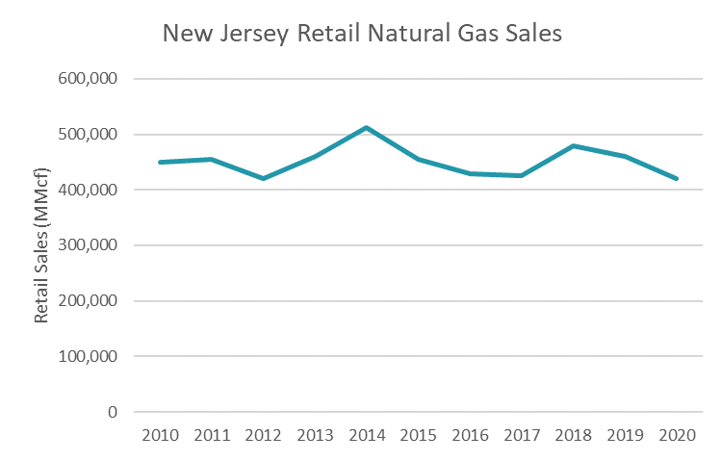
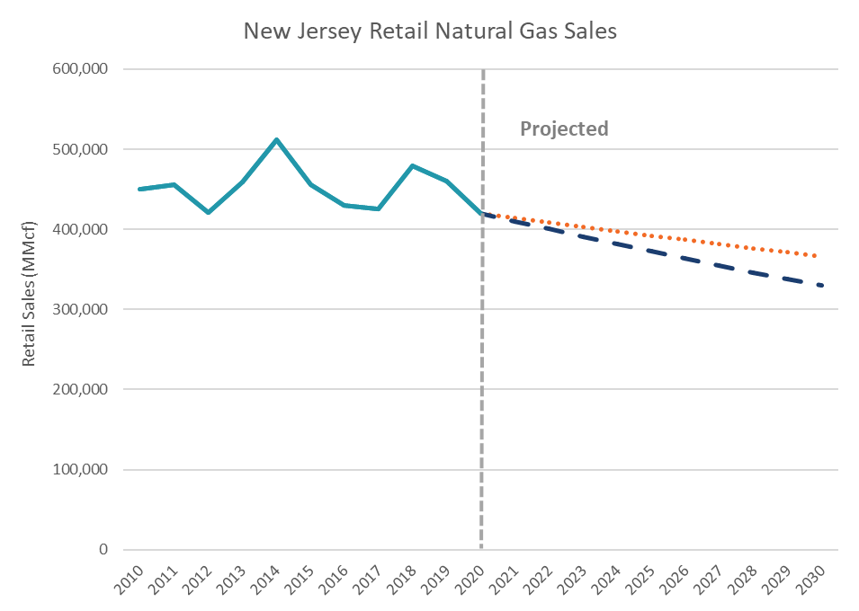
EIA data implies decline in natural gas usage
Building decarbonization
Step 1: Obtain historical rates of change in natural gas use before the EE effect
Step 2: Use the historical rates for projections
-1.37% CAGR
-2.4% CAGR
EMP Least Cost
Historical Rates of Change |  | Last 5 years 2015-2020
Yearly Sales Change after EE (CAGR from plot above) | [A] | -1.61%
Yearly Sales Change due to EE (from ACEEE) | [B] | -0.24%
Yearly Sales Change before EE | [A]-[B] | -1.37%
Rate of change before EE is used to estimate the effect of decarbonization.
Data source: EIA, New Jersey Natural Gas Consumption by End Use (eia.gov). Retail natural gas sales include volumes delivered to residential, commercial, and industrial customers.

Slide 42
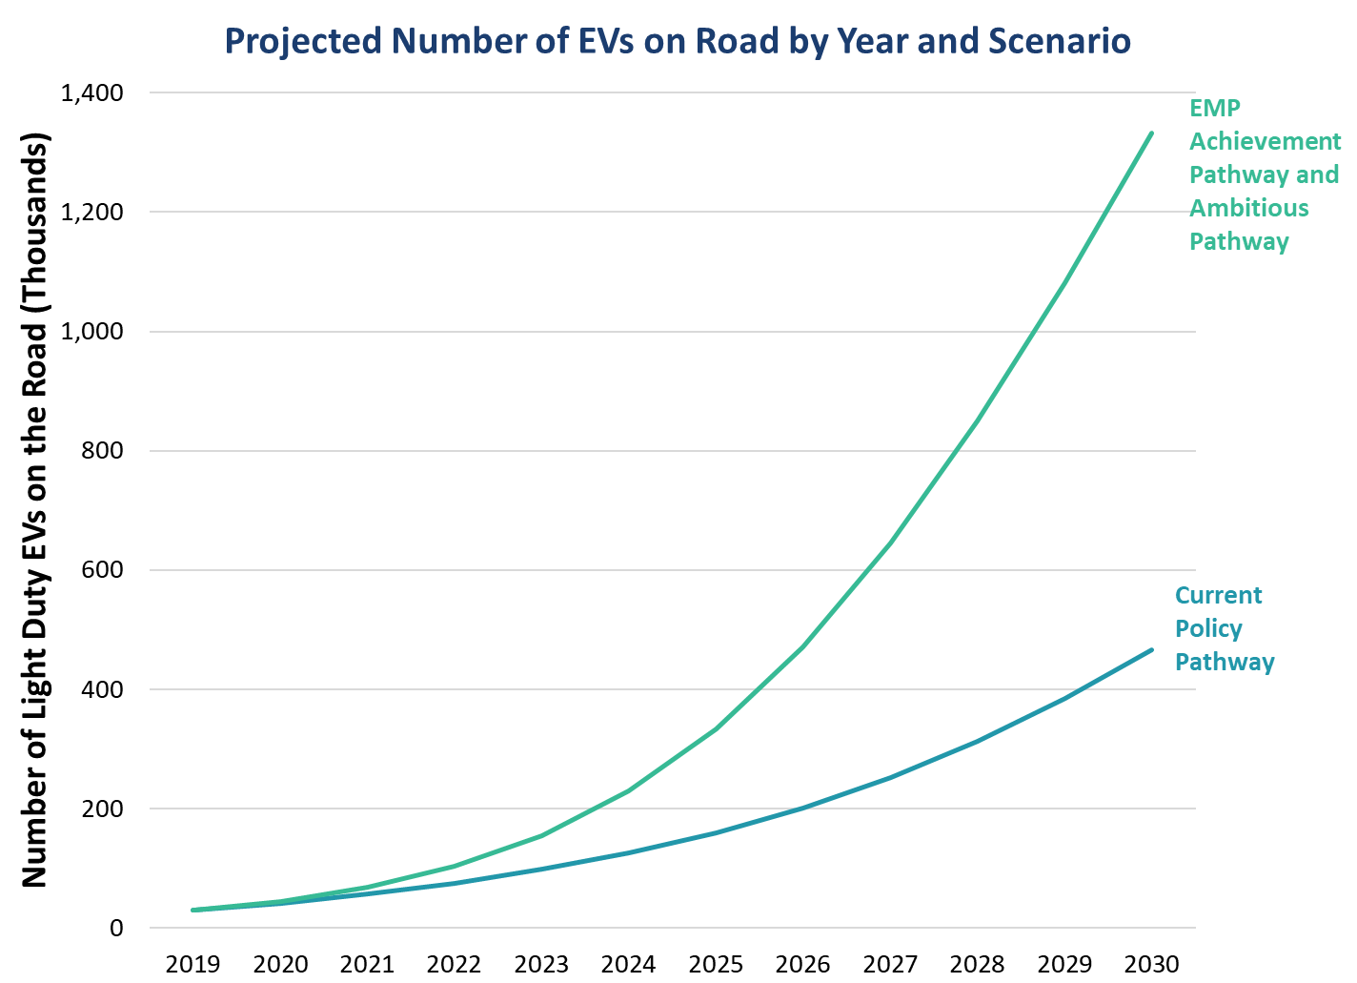
Step 1: EV Projections for 2025 and 2030
transportation electrification
  The EMP Achievement Pathway and Ambitious Pathway cases reach 330K electric light duty vehicles in 2025. In 2030, 85% of sales are electric, and New Jersey reaches 1.3 million electric vehicles, representing 28.6% of stock.
  In the Current Policy Pathway case, which is based on existing market conditions, New Jersey reaches 159K electric light duty vehicles in 2025. In 2030, 30% of sales and 10.4% of stock (467K vehicles) are electric vehicles.

Slide 43
Public Comments
All comments received during this meeting will be added to the official record on this docket.
We ask that all speakers keep comments relevant to
the Ratepayer Impact Study as being presented.
We also ask that speakers be concise by presenting key points to allow time for all registered speakers.
If we have additional time in the meeting, speakers may be invited to provide more comment.
03/25/2022
www.nj.gov/bpu

Slide 44
Docket No. EO22030130
Written Comments
The Board will be accepting written comments on this matter until 5pm E.D.T. on April 8, 2022.
Please submit comments directly to the specific docket listed above via email: board.secretary@bpu.nj.gov.
While electronic comments are preferred, written comments may also be mailed to the Secretary of the Board, at the Board of Public Utilities, 44 South Clinton Avenue, 1st Floor, P.O. Box 350, Trenton, NJ 08625-0350.
03/25/2022
www.nj.gov/bpu

Slide 45
Thank You!
03/25/2022
www.nj.gov/bpu

